Slide 1
AMBULANCE TRACKER
TEAM MEMBERS:
ARUN GANDHI.R
DILKUSH.S
JEGAN NIVAS.T
GUIDED BY,
Ms. MOHANA GOWRI
ASST.PROFESSOR
DEPT OF CSE

Slide 2
ABSTRACT
Ambulance tracking service so that nearby persons can plan whether to wait for ambulance or take the patient to the hospital through his own resource in emergency, can track the nearest ambulance before booking and can contact the driver allotted.

Slide 3
EXISTING SYSTEM
It will not ask for any confirmation of contacting the ambulance driver.
The user cannot directly contact or choose the ambulance nearby.
It only trace the user’s location alone and dispatch it to the call center.

Slide 4
PROPOSED SYSTEM
Live tracking and status information of all available ambulances in a map which helps for quick redirection of the ambulance to a critical spot.
Ask secondary confirmation from the user before making a call to the nearest ambulance driver.
Proposed system provide direct interaction between the user and the ambulance driver.

Slide 5
MODULE DESCRIPTION
Login module:
The user can register if he/she is using this for the first time.
The user can login using g-mail and the password.
The driver must login with the provided mail-id and the password
The user can logout if required.

Slide 6
MODULE DESCRIPTION
Locating Ambulance
After login the user will be able to view his current location. On clicking the nearby ambulance button the ambulance locations along with the distance from the user, driver name and his number is displayed.
Selecting the nearest ambulance an OTP is provided for the user.

Slide 7
MODULE DESCRIPTION
Confirmation:
Automatically call is connected to the respective ambulance driver the user just need to pass the OTP provided.
The driver will make the note of the OTP which will be used to provide the location of the user.
If the ambulance driver is not available then the user must look for some other nearby ambulance.

Slide 8
MODULE DESCRIPTION
Driver Map View:
On receiving the OTP from the user, the driver will enter the OTP and using the navigate option the driver will get the users location.
With that location the driver can navigate to the user with the google maps.

Slide 9
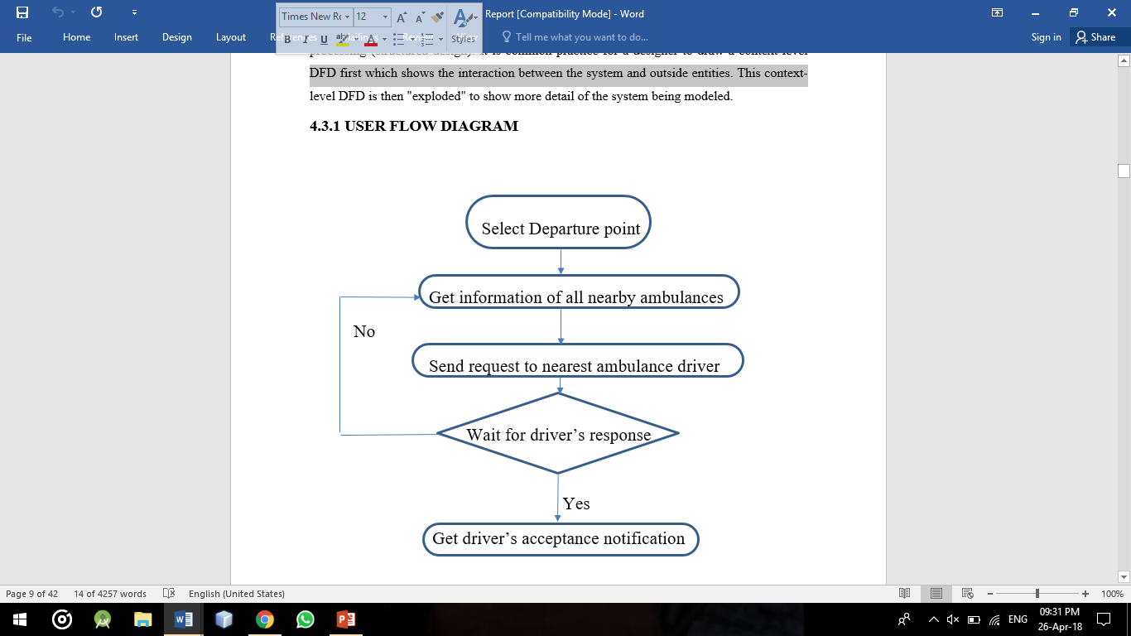
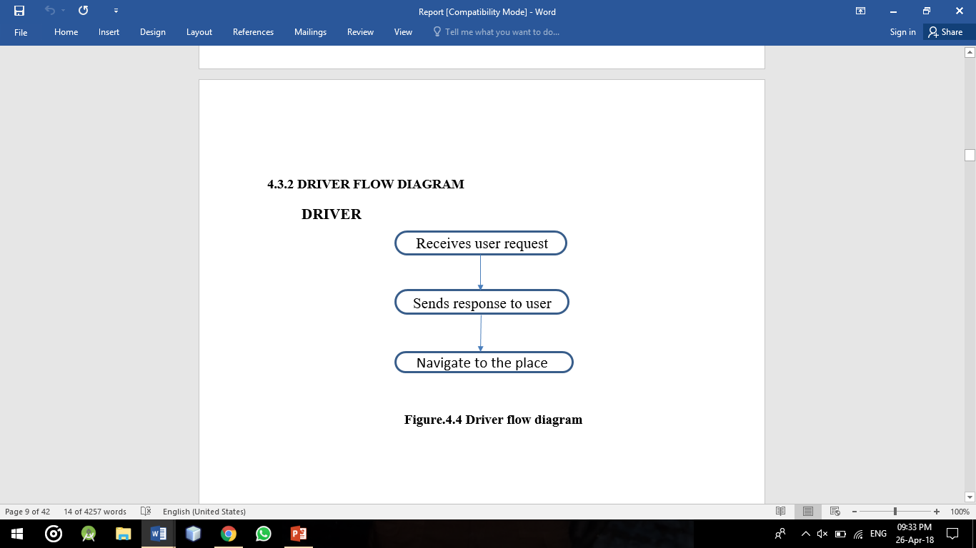
FLOW DIAGRAM

Slide 10
CONCLUSION
When there is an emergency, first thing authorities would want to do is get the nearest team on spot at the earliest. Trying to call all ambulance drivers on road to know their locations is not the right way to go about it takes time. Thus with the help of proposed system(Ambulance tracking System), you could find out the vehicles nearby the incident/accident location, just get the driver contact number and assign them the task.

Slide 11
FUTURE ENHANCEMENT
Initially it will track the nearest ambulance location alone. In future based on the success we will incorporate our system to locate nearby hospitals.
So that we can locate nearby doctors for first aid.
User can share any other location where help is needed apart from their own current location.

